Slide 1
Office Management Presentation

Slide 2
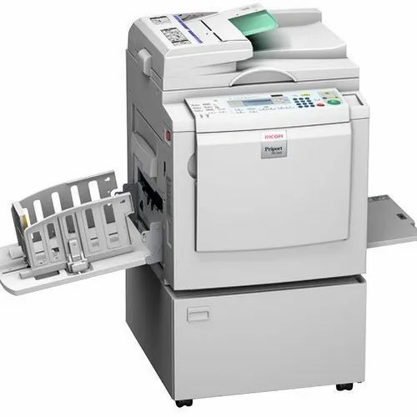
DUPLICATING MACHINE
1. modern document-reproduction have evolved from duplicating maching.
2.Digital duplicators,scanner,laser printer and photocopiers have since replaced them.
3.it makes copies of documents by a master copy from which copies are by machine.
4.most frequently employed in schools and small businesses where effectiveness is required.
5.it is used to make newspaper,magazines and pamplates.
ways to duplicate:
1.type write
2.press copying
3.stencil duplicator
4.photostat

Slide 3
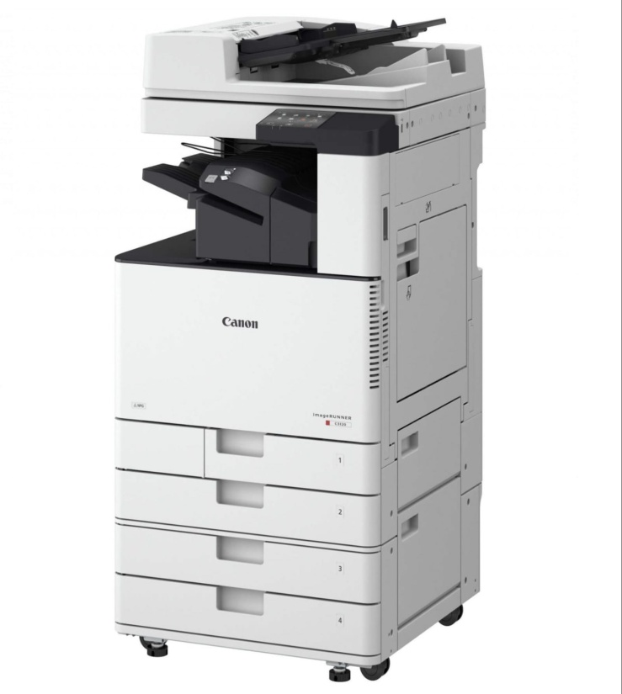
PHOTOCOPYING MACHINE
1.the majority know is by its the brand name Xerox who manufactures it.
2.it quickly and cheaply papers and visuals and print them on paper.
3.used for contractor to make a copy of a contract.
4.Xerography is a dry technique that employs electrostatic chagers on a light-sensitive photoreceptor to attract and transfer toner particles (a powder) onto the paper in the shape of an image in most modern photocopies.
5.advantages are that it is quick,clean,process,it prints on both sides,and we can also get the digital copies as well
6.there are colour and monochrome photocopying machine
7.but it is expensive,takes a lot of paper which leads to environmental concerns and government has to take extra measures to make sure there are no counterfeit currency.
other machines like fax(fascimile) and franking machine are also used in offices

Slide 4
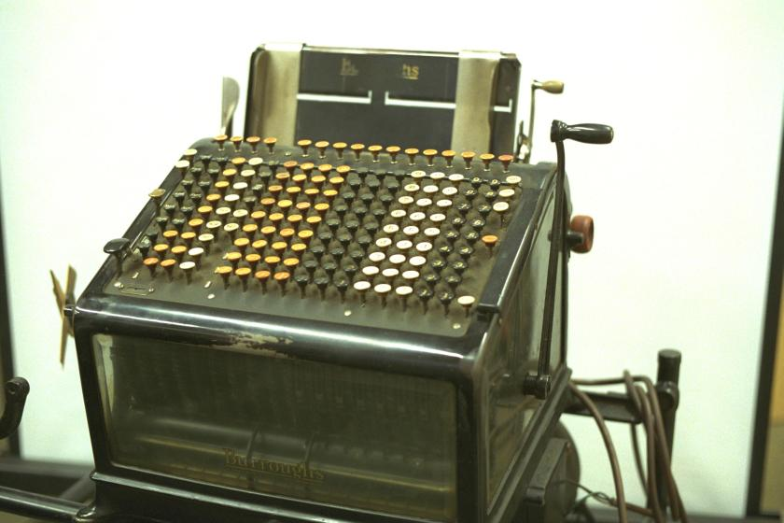
ACCOUNTING MACHINE
1. Accouting machines were used by businesses from 1900 - 1980s.
2. It was a device which were used to record the financial information.
3. They were a combinatin of Calculator and Printer which were used for specific commercial activities like billing, payroll or ledger.
4. To sum it up, these devices were used for Calculating,Tabulating and printing the results.
ADVANTAGES:
time and labour saving,more accurate,Better Presentation,simple balancing, immediate use of valuable information
DISADVANTAGES:
heavy investment,cause Distraction,Breakdown, depreciation

Slide 5
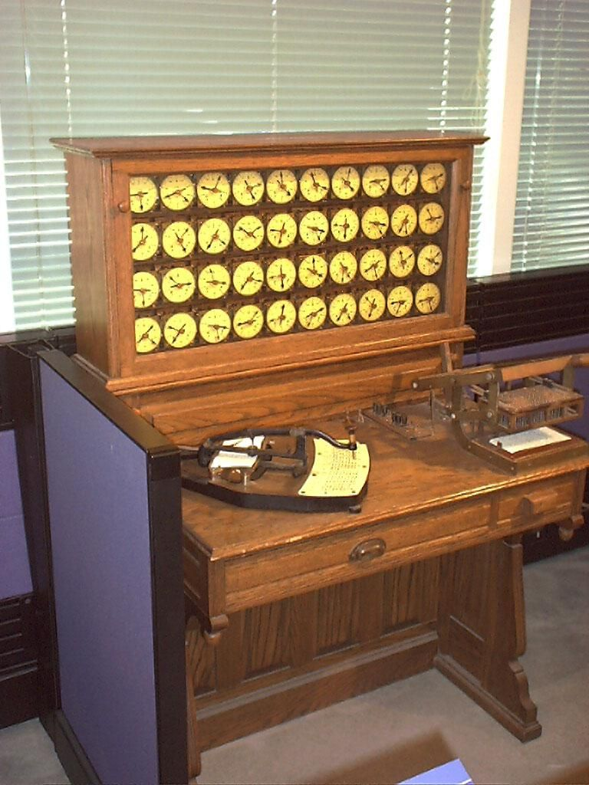
TABULATING MACHINE
1.sorting information into classes and adding up the total for each class are two processes that combined by these machines.
2.cards are punched with the punching card machine and then stored to tabulate statistical information by this machine.
3.Tabulation is printed in columns and rows on paper once tabulation has been completed.
4.nowadays we use microsoft exel.
5.it is used in offices that has heap of data that need to processed on daily basis.

Slide 6
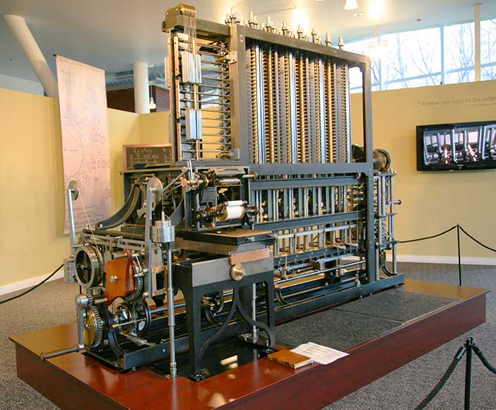
COMPUTING MACHINE
Calculating machines are used to perform mathematical functions such as addition, subtraction, division, and multiplication as well as percentage, square, square roots and so on. It also helps in performing repetitive and routine statistical work. Calculators include memory banks. The majority of conventional calculating machines are non-listing machines, with the final totals shown on the machine's dial. Calculators help you save time and effort. They complete the task swiftly and precisely. They are portable and alleviate mental strain. Calculators are extremely handy for calculating interest, discounts, dividends, and exchange rates, among other things.

Slide 7
Advantages of Calculating Machines
Following are the advantages of calculating machines:
It helps in fast calculations.
It provides accurate results of the mathematical problems.
is easy to access calculators.
Calculators can be even carried in pockets and are portable in nature.the simple mathematical calculations like addition and subtraction.
Disadvantages of Calculating Machines
Following are the disadvantages of calculating machines:
In initial, investment in calculating machine is quite expensive.
Results obtained from the calculators are required to be checked.

Slide 8
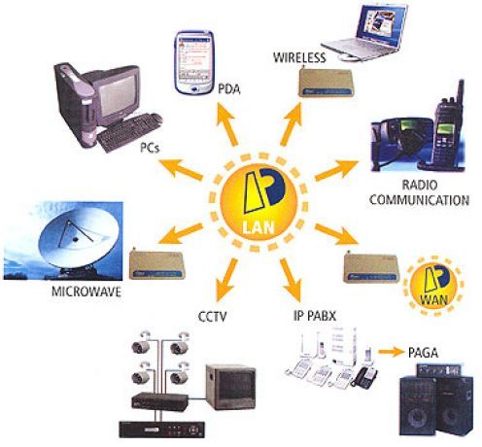
COMMUNICATION MACHINE:
Office requires communication equipment for the smooth functioning of the work. These equipment's assist in transferring messages, data and other information from one place to another. Following are the communication equipment's which are discussed below:
Communication equipments:
Dictaphone
Telephone
Teleprinters
PBX
Intercom
Telex
PABX
STD

Slide 9
THANK YOU
Notes:
THANK YOU

